Slide 1

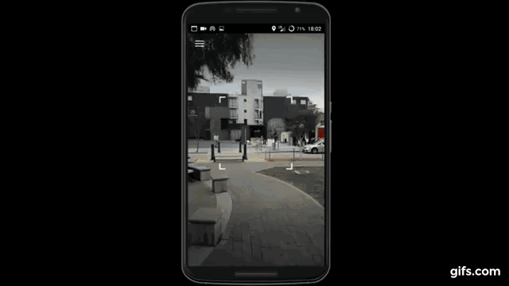

Slide 2
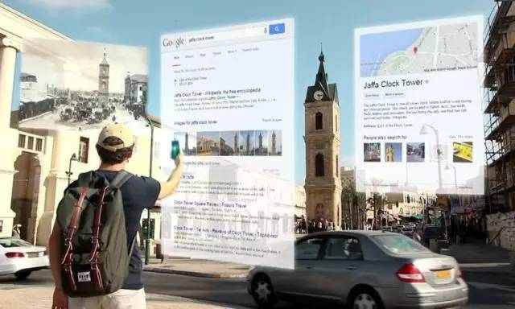
Business Model
LBS based search engine
e.g., Yelp, 大众点评

Slide 3
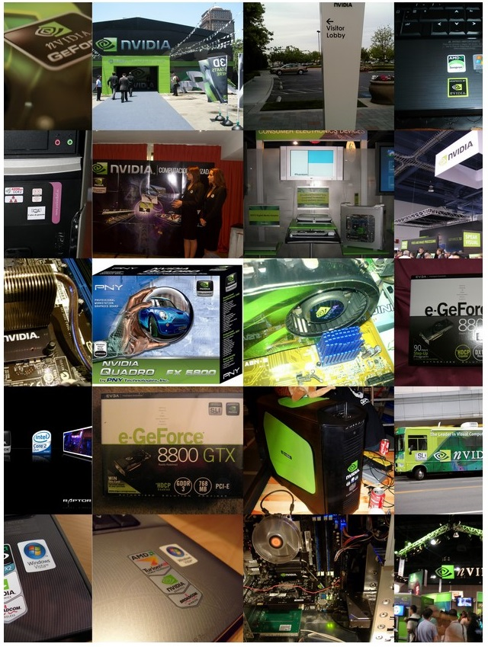
Business Model
2. Logo or brand detection

Slide 4
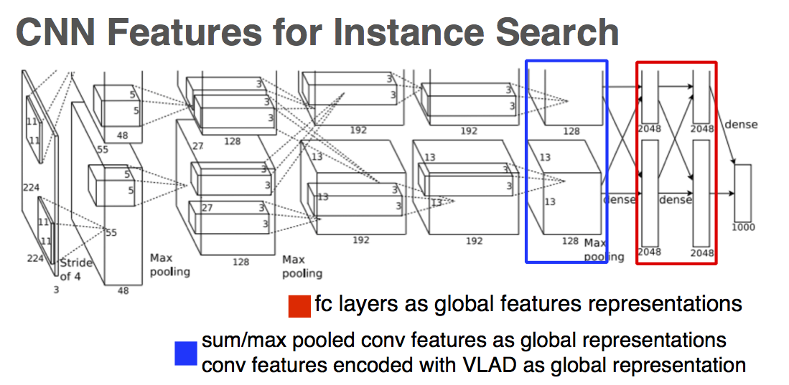
Solutions: Instance/image retrieval

Slide 5
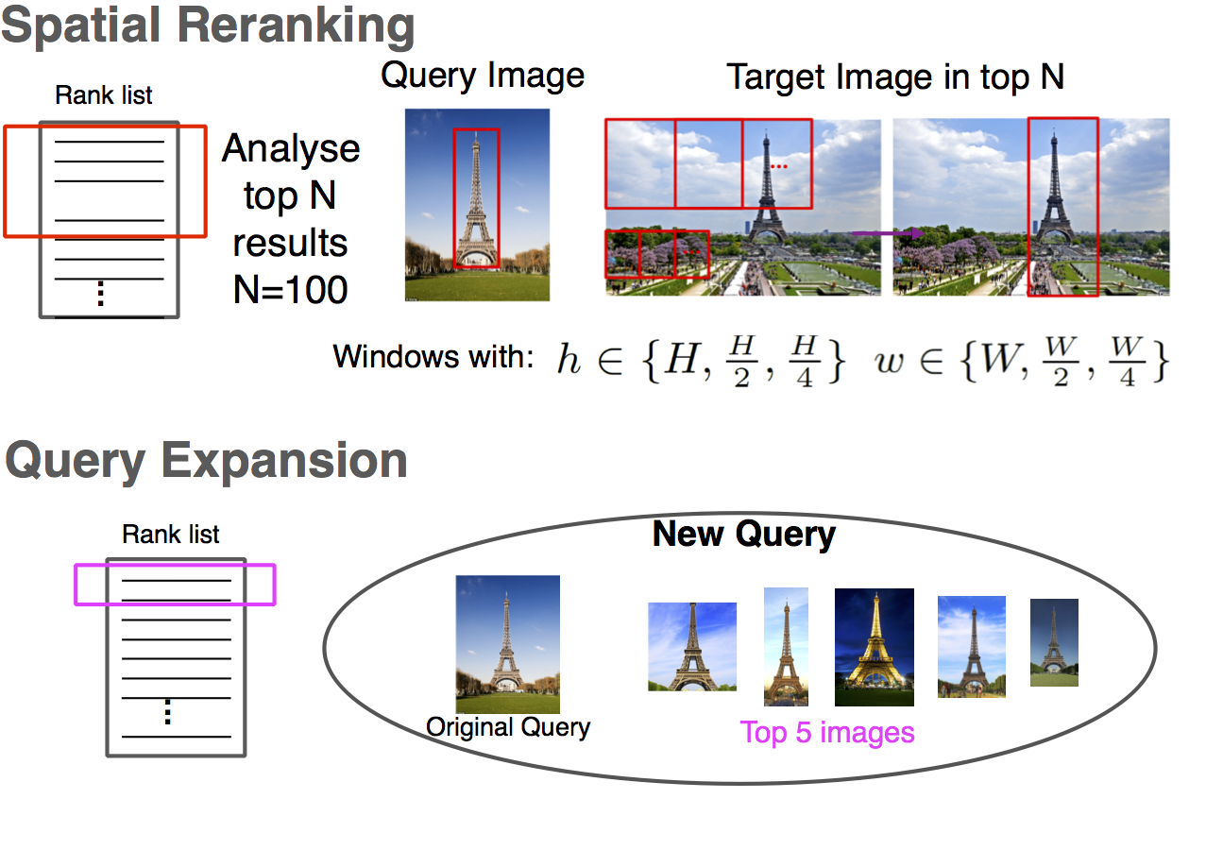
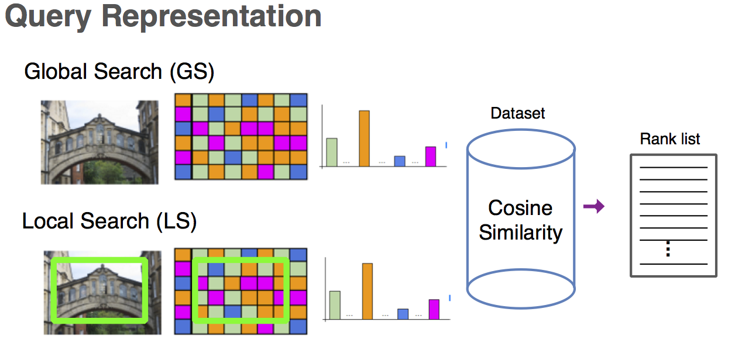
Bags of Local Convolutional Features for Scalable Instance Search
ACM International Conference on Multimedia Retrieval 2016

Slide 6
2016 IEEE Conference on Computer Vision and Pattern Recognition
Faster R-CNN features for Instance Search

Slide 7
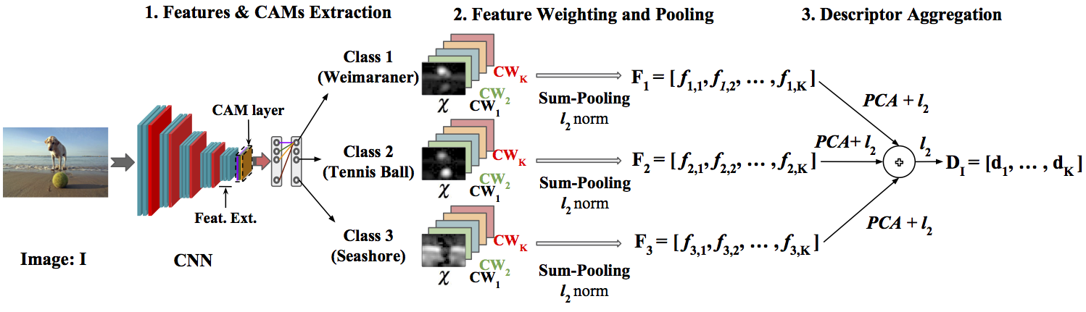
Class-Weighted Convolutional Features for Image Retrieval
28th British Machine Vision Conference (BMVC 2017)

